Slide 1

5 Components of Health Related Physical Fitness

Slide 2
Fitness Defined
(Health-Related) Physical Fitness
  Measure of a person’s ability to perform physical activities requiring:
    Endurance
    Strength
    Flexibility
Notes:
(defined on slide) – as found in PB Teacher’s Guide (p.5 in the 2nd edition)

Slide 3
Physical Fitness Includes
Skill-Related Fitness
Health-Related Fitness
Notes:
Skill-related components - Basic skills and concepts common to all movement forms are needed for students to become self-sufficient in health-related fitness activities (Teacher’s Guide – p.157)
Health-related components - Each of the health-related fitness concepts is specific to physical health.
We’ll briefly examine each of the skill-related and health-related components (next slide)

Slide 4
Skill-Related Fitness Components
Agility
Balance
Coordination
Power
Reaction time
Speed

Slide 5
Skill-Related (cont)
Genetics
Wide range of ability in your age group
Skills are sport-specific
Example: Football=Power
Basketball=Speed

Slide 6
Components of Physical Fitness
Cardiorespiratory Endurance
Muscular Endurance
Muscular Strength
Flexibility
Body Composition

Slide 7
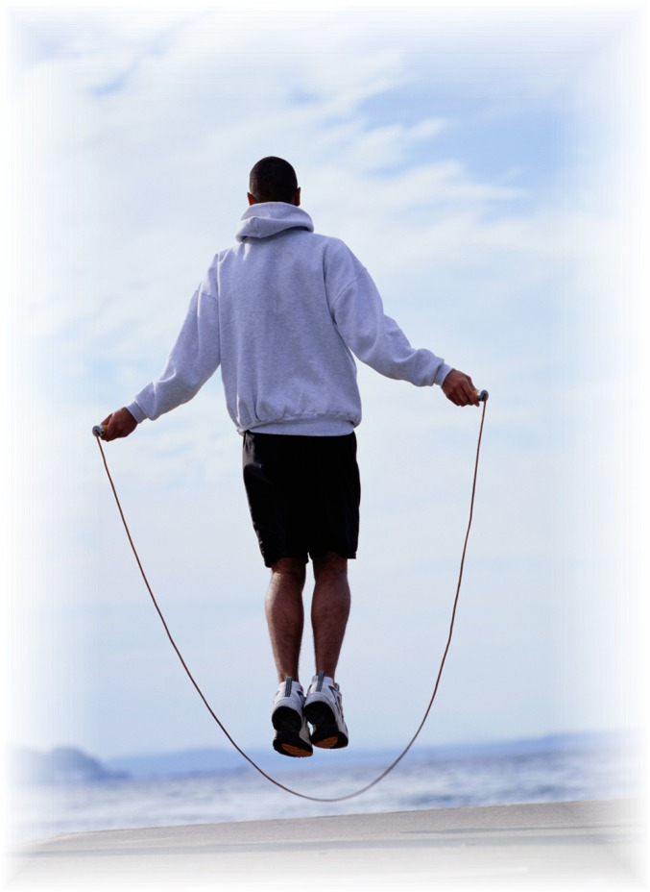
Cardiorespiratory Endurance
Definition - the ability to deliver oxygen & nutrients to working muscles over sustained periods of time.

Slide 8

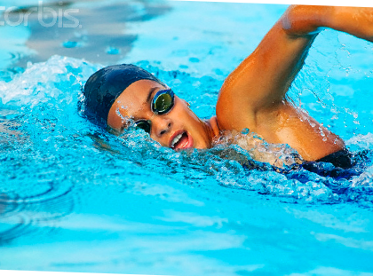
Best way to improve cardiorespiratory endurance is through aerobic exercise.
1. Running
2.Jogging
3. Swimming
4. Rowing
5. Elliptical
Other Examples?

Slide 9
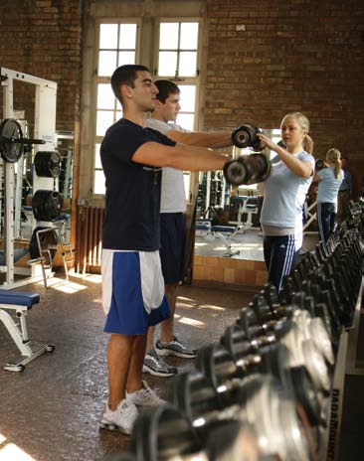
Muscular Endurance
Definition - the ability of a muscle or muscle group to repeat a movement many times or to hold a particular position for an extended period of time.

Slide 10

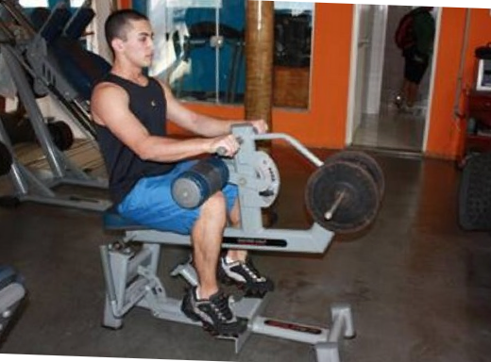
Best way to improve muscle endurance:
1. Lift weights- Lighter Weight-MANY REPS
2. Body Weight Exercises
3. Rep Range is 15-25

Slide 11
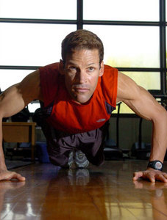
Muscular Strength
Definition - the ability of a muscle to exert MAXIMUM force for a brief period of time.

Slide 12
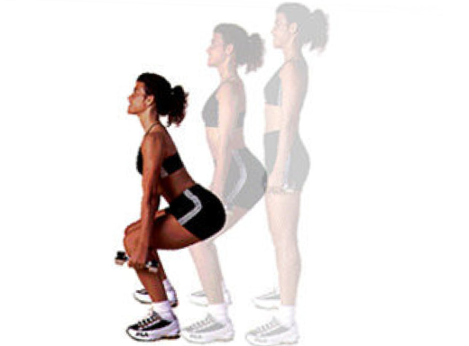
Ways to improve muscle strength:
1. Lift weights: HEAVIER WEIGHT- low reps
2. Rep Range is between 8-12

Slide 13
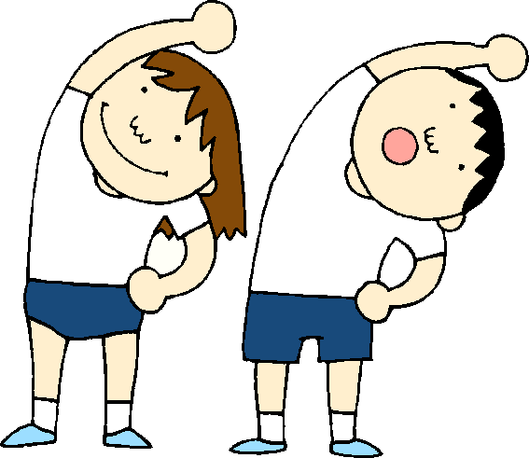
Flexibility
Definition - the ability to move joints and use muscles through their full range of motion.

Slide 14
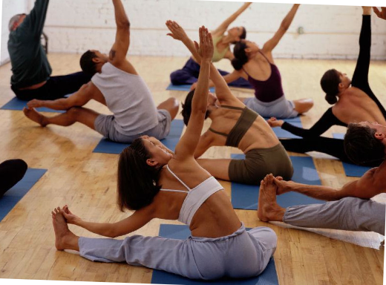
Types:
1.Static- stretches involve NO MOVEMENT
2. Dynamic- movement is involved during stretching

Slide 15

Body Composition
Definition - the amount of fat in the body compared to the amount of lean mass (muscle mass)

Slide 16

Lean Body Mass
Muscles
Bones
Tendons
Ligaments
Organs

Slide 17
Body Comp (cont)
Measured by
  BMI (Body Mass Index)
  Depends upon Height and Weight
Flaws- doesn’t take into account a person’s muscle mass

Slide 18
FITT Principle
F- frequency
  ( how often) 3 days a week, 5 days a week
I- intensity
  (how hard) walk, sprints, jog, 8 reps, 12 reps, 15 reps, 25 reps. Vigorous, moderate, or easy
T- type
  (What kind) weights (muscle strength, endurance) Run (Cardio) Stretch (flexibility)
T-Time
  (how long) 1 hour, 2 hours, 30 minutes, 2 minutes

